Slide 1
Distributed data through transactional messaging patterns (this time with actual implementation using .NET)
By Volodymyr Bartish
Notes:
Before the presentation would be nice to get a poll results and understand the following:
How many participants ever worked with event sourcing
How many participants ever tried to perform events aggregation or used windowing technique
How many participants have at least basic understanding of kafka (if you know what topics, partitions, brokers, producers and consumers are – I’d say you have the basics)
How many participants ever built something with kafka or any other event streaming platform
Pre-requisites:
Participants should feel comfortable reading .NET code
Participants should feel comfortable reading T-SQL (any dialect)
Participants should have at least basic understanding of Docker (not necessary practical experience)

Slide 2




About me
Big fan of distributed systems
Mostly focused on .Net
Want to get in touch and/or grab a coffee? Mailto: vbart@softserveinc.com, bartishv@gmail.com
Over 10 years of professional
“I’ve got a bad idea”

Slide 3

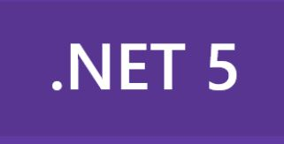





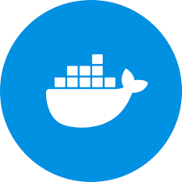

Appetizer - Tools: we’ll take a bite of all of these, at least a small one.
Project Tye
Debezium

Slide 4
Appetizer - patterns: We’ll use and/or implement all of these
Transaction log tailing
Tansactional outbox
Polling publisher

Slide 5
Preface
Nowadays distributed systems are everywhere.
As such systems evolve they become extremely complex.
One of the biggest factors in the complexity growth is coupling between the components.
Naturally the questions stands: “How do we build a loosely coupled distributed system that:
Has reasonable data availability
Is relatively easy to extend and evolve
Has good auditing capabilities
Consistent enough
Reasonably fast”?
One of the frequently seen use cases to consider – monolithic systems integration and/or rebuilding.

Slide 6
So what’s cookin’?
Given:
Monolithic application with MS SQL Server database as a persistence storage.
Constraint – impossible to “strangle” all the writers to the storage in a reasonable timeframe.
Problem:
Make data available on the Kafka “event bus” so that we could build new services in loosely coupled manner

Slide 7
Setup

Slide 8
A word about Apache Kafka
If you are not familiar with it at all – no worries, I will describe the basics.
If you want more detailed explanation – please visit these:
https://www.youtube.com/watch?v=FKgi3n-FyNU
https://www.youtube.com/watch?v=B5j3uNBH8X4
https://kafka.apache.org/documentation/

Slide 9
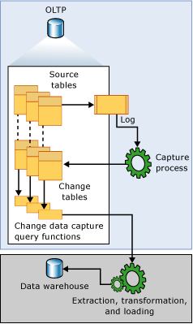
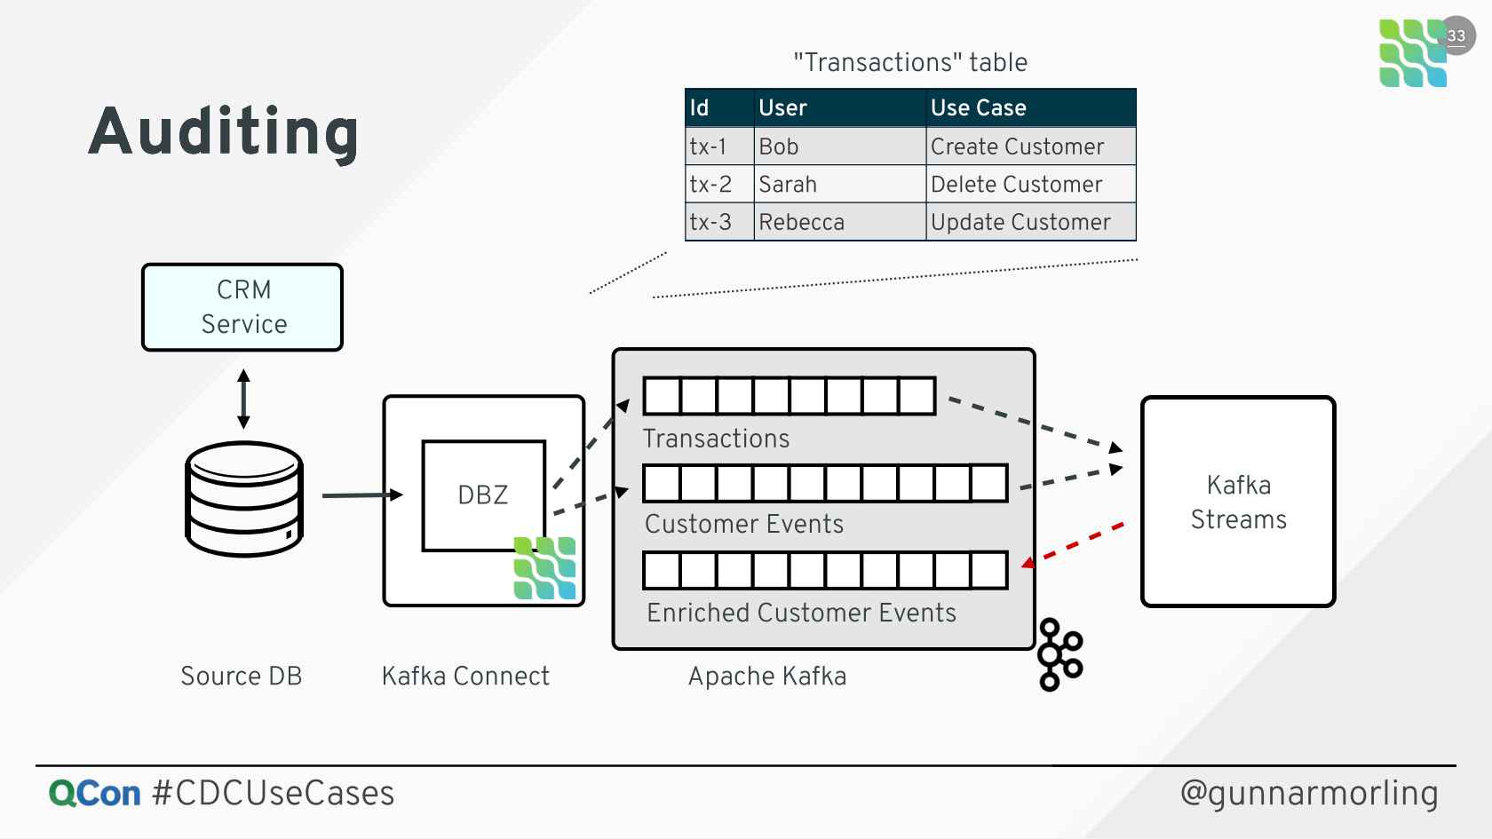
Transaction log tailing
SQL Server CDC
On Jan 01, 2020, Gunnar Morling, lead engineer of the Debezium project did a talk at QCon conference where he discussed a Change Data Capture technique.

Slide 10

Let’s get the events on the

Slide 11
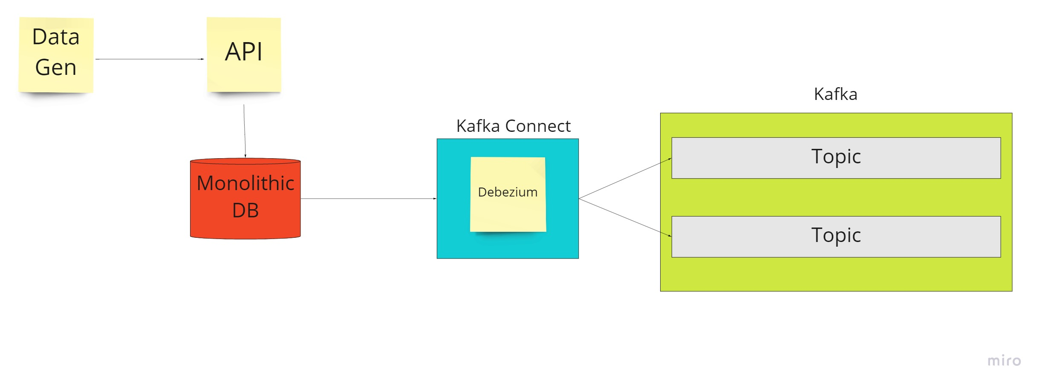
Where are we?

Slide 12
Let’s stir the dish until it’s ready. Just kidding, let’s implement aggregation instead

Slide 13
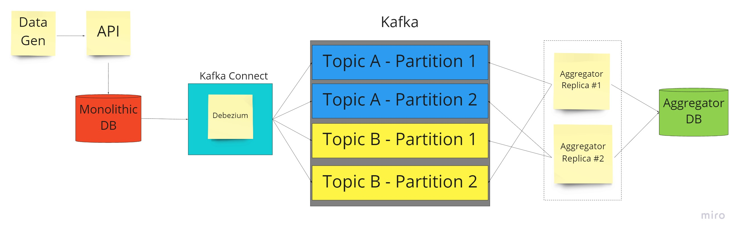
Where are we?

Slide 14
Serve it!

Slide 15
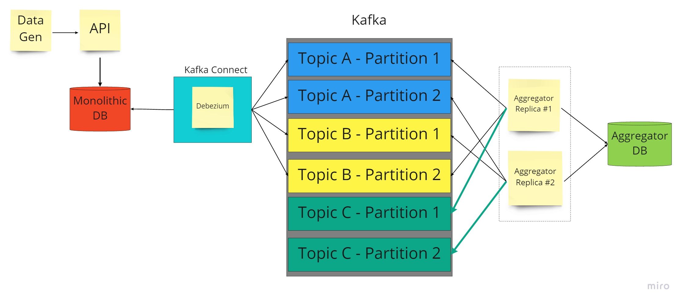
Done!

Slide 16
Q&A

Slide 17
Thank you!

